Slide 1


Using computer vision & deep learning to predict poverty and aid in data-sparse contexts
Woojin Jung, Ph.D.
Assistant Professor
Rutgers University, the State University of New Jersey
August 21st 2020
Notes:
안녕하세요? 뉴저지 주립대 사회복지학과에 정우진이라고 합니다.
먼저 COVID 19의 상황에서도 발표자들과 토론자들이, 참석자 분들이 함께 토론할할 수 있는 자리를 마련해 주신 KAIDEC 관계자분들 및 서울대 행정학과 교수님, 연구진께 감사인사드립니다.
저는 월례회에 아주 초창기 2011년쯤인가요. 작은 식당에서 한국형개발협력 모델에 대해 발표한적이 있었던것 같은데, 오늘이 거의 10년만인 두번째여서 감회가 새롭고 그간 학회와 월례회 모두 규모가 커지고 성장한것 같아 반갑습니다.
오늘은 제가 작년 5월정도에 NSF 펀딩을 받아 UC Berkeley에서 진행한 연구중의 하나인 computer vision과 deep learning을 활용한 빈곤측정 기법에 대한 공유를 하고자 합니다.

Slide 2
Background

Slide 3
Data science approach to development aid
Data science
  Social science (Domain expertise)+ Computer science + Math/Statistics
Big data
  Large collection of digitized information
Machine Learning (ML)
  Recognize patterns in data and predict
Deep learning
  A subset of ML that uses multi-layered artificial neural networks
Artificial Intelligence (AI)
  The use of computer systems for automated decision-making to be able to perform tasks similar to those of human intelligence
Notes:
먼저 간단히 제 연구분야를 말씀드리면, 저는 박사과정에서 사회복지와 Development Engineering 즉 개발공학을 같이 전공하였고, 데이터 사이언스를 통해서 국제빈곤에 대한 다양한 측정방법을 개발하고, 이를 취약국의 지역개발 정책이라던가, 국제빈곤측정 지표를 개발하는데 사용하는 것이 관심이 있습니다.
데이타사이언스는 CS와 통계적 지식, informatics, media 등이 결합되어 다양한 사회적 현상을 분석하고 이를 문제해결에 활용하는 학문영역이라고도 볼 수 있습니다. 여기서 쓰이는 데이터는 구조화되지 않은 대규모의 데이타이고, 우리는 머신러닝을 통해 익숙하지 않았던 데이터 셋 들의 패턴을 분석하고 예측을 하는데 쓸 수 있으며, 특히 사람의 지능을 모방한 자동화된 결정에 컴퓨터를 활용하는 인공지능을 활용할 수 있습니다.
I want to talk about three measurement techniques that help match need and aid.
We can measure poverty in Berkeley from census survey. However suppose that if we want to measure poverty at a granular level within 10 mile radius of the Haviland hall, there won’t be survey data specific to that location.
So we can use other sources like satellite imagery.
30 sec
technology I want to tell you about is geospatial analysis.
What’s so special about spatial analysis?
Geospatial analysis helps us explore spatial patterning in variables that vary a lot from place to place. Many of us already have incorporated geographic variation into our studies. For example, we look at how different Medicaid policies across state affect the health and financial wellbeing of single mothers and children. Here we treat the state as a homogenous policy space, but for a variable such as toxic gases might have different levels of concentration even between where you and I are sitting. In this case, it might be less useful to look at state or county level differences, but it requires a much finer level of analysis – say by 1 sqm.
It can also be used to estimate the values of some property at locations where there are no samples available.
Spatial Analysis in aid distribution is beginning to be used in African country context by some authors like Brigg and Findley, but it’s still at a higher administrative level and still in a rudimentary stage.
My goal is to use this technology at much finer level of analysis (using granular data) because my orientation is to look at this model of need and distribution of aid in a small region with no actual data.
It helps us explore spatial patterning in variables that varies a lot from place to place. Many of us already have incorporated geographic variation in our studies. For example, we would look at how different Medicaid policy across state affect the health and financial wellbeing of single mother and children. Here we treat state as a homogenous policy space. But for a variable like toxic gases might have different levels of concentration even between the space of where I’m and where you’re. In this case, it might be less useful to look at state or county level difference but it requires much finer level of analysis – say by 1 sq m.
(14)

Slide 4
New Measurement Techniques
Tap into new sources of data
  Mobile phone
  Remote sensing data
  Crowd sourcing
Create new variables
  Validate & calibrate new measurements
Notes:
이러한 새로운 접근법을 통해서 모바일이나 인공위성 데이터, 크라우드 소싱을 통해서 기존의 사회 경제적 지표들을 보완할 수 있는 새로운 지표를 만들수가 았습니다.
I want to talk about three measurement techniques that help match need and aid.
We can measure poverty in Berkeley from census survey. However suppose that if we want to measure poverty at a granular level within 10 mile radius of the Haviland hall, there won’t be survey data specific to that location.
So we can use other sources like satellite imagery.
30 sec
technology I want to tell you about is geospatial analysis.
What’s so special about spatial analysis?
Geospatial analysis helps us explore spatial patterning in variables that vary a lot from place to place. Many of us already have incorporated geographic variation into our studies. For example, we look at how different Medicaid policies across state affect the health and financial wellbeing of single mothers and children. Here we treat the state as a homogenous policy space, but for a variable such as toxic gases might have different levels of concentration even between where you and I are sitting. In this case, it might be less useful to look at state or county level differences, but it requires a much finer level of analysis – say by 1 sqm.
It can also be used to estimate the values of some property at locations where there are no samples available.
Spatial Analysis in aid distribution is beginning to be used in African country context by some authors like Brigg and Findley, but it’s still at a higher administrative level and still in a rudimentary stage.
My goal is to use this technology at much finer level of analysis (using granular data) because my orientation is to look at this model of need and distribution of aid in a small region with no actual data.
It helps us explore spatial patterning in variables that varies a lot from place to place. Many of us already have incorporated geographic variation in our studies. For example, we would look at how different Medicaid policy across state affect the health and financial wellbeing of single mother and children. Here we treat state as a homogenous policy space. But for a variable like toxic gases might have different levels of concentration even between the space of where I’m and where you’re. In this case, it might be less useful to look at state or county level difference but it requires much finer level of analysis – say by 1 sq m.
(14)

Slide 5
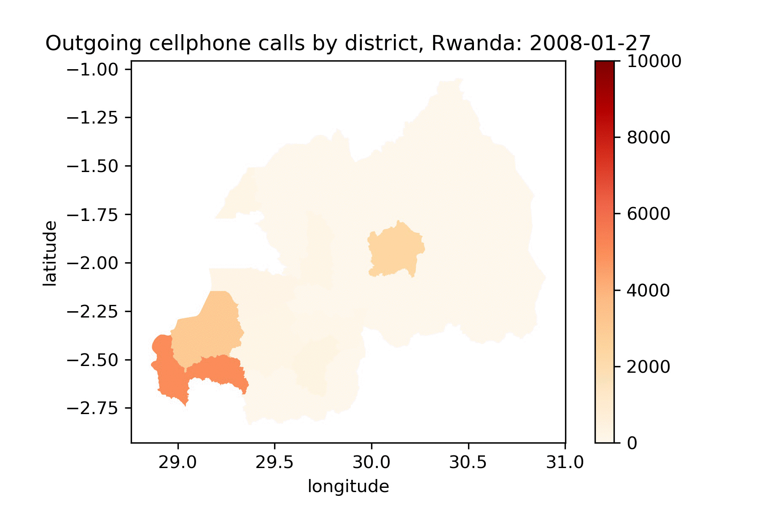
Example
Notes:
이것은 재난재해로 인해 야기되는 이주를 모바일 폰 데이터를 통해 측정하였던 연구의 예인데, 르완다 자기 지역에서 다른 지역으로 전화하는 양을 실시간으로 측정한 것입니다. 혹시 이걸 보시고 왼쪽 아래 Lake Kivu 지역에서 지진이 일어난 날짜에 대해서 예측하실 수 있을까요?

Slide 6
New Measurement Techniques (cont.)
Modeling relationship
  Non-parametric methods: don’t make explicit assumptions about the functional form of f
Notes:
또한 ML은 기존의 parametric 한 분석보다 더 유연하고 y hat에 대한 예측력이 높습니다. Income y는 educatio과 seniorit의 linear combinatio이라는 심플한 가정하고 직관적으로 이해하기 쉬운 가정을 하지 않기 때문에, 어떤 변수가 어떤 가중치로 영향을 미쳤는지는 모르지만, 특정 교육수준과 특정 근속연수 넣었을때 나오는 소득에 대한 예측이 보다 정확합니다.
I want to talk about three measurement techniques that help match need and aid.
We can measure poverty in Berkeley from census survey. However suppose that if we want to measure poverty at a granular level within 10 mile radius of the Haviland hall, there won’t be survey data specific to that location.
So we can use other sources like satellite imagery.
30 sec
technology I want to tell you about is geospatial analysis.
What’s so special about spatial analysis?
Geospatial analysis helps us explore spatial patterning in variables that vary a lot from place to place. Many of us already have incorporated geographic variation into our studies. For example, we look at how different Medicaid policies across state affect the health and financial wellbeing of single mothers and children. Here we treat the state as a homogenous policy space, but for a variable such as toxic gases might have different levels of concentration even between where you and I are sitting. In this case, it might be less useful to look at state or county level differences, but it requires a much finer level of analysis – say by 1 sqm.
It can also be used to estimate the values of some property at locations where there are no samples available.
Spatial Analysis in aid distribution is beginning to be used in African country context by some authors like Brigg and Findley, but it’s still at a higher administrative level and still in a rudimentary stage.
My goal is to use this technology at much finer level of analysis (using granular data) because my orientation is to look at this model of need and distribution of aid in a small region with no actual data.
It helps us explore spatial patterning in variables that varies a lot from place to place. Many of us already have incorporated geographic variation in our studies. For example, we would look at how different Medicaid policy across state affect the health and financial wellbeing of single mother and children. Here we treat state as a homogenous policy space. But for a variable like toxic gases might have different levels of concentration even between the space of where I’m and where you’re. In this case, it might be less useful to look at state or county level difference but it requires much finer level of analysis – say by 1 sq m.
(14)

Slide 7
e.g.) Deep learning models in health
Algorithms | Precision | Recall
Logit (Baseline) | 0.577 | 0.17
Decision Tree | 0.580 | 0.547
Multilayer Perceptron | 0.604 | 0.782
Convolutional Neural Network | 0.678 | 0.61
Recurrent Neural Network (Long Short Term Memory) | 0.569 | 0.165
Support Vector Machine | 0.397 | 0.409
Random Forests | 0.552 | 0.120
Jung et al. (2018) Predicting Hospital Readmission. Health insurance claims data with 45,000 patients 939 features
Notes:
예를 들어 이것은 제가 insurance claims 데이터를 분석해서 45000 환자의 939 변수를 가지고 병원 재입원률을 계산한 것인데, 기본적인 logistic regression보다 Multilayer perceptron과 같은 ML 모형들의 error가 훨씬 작았습니다.
-Precision: true positive out of all positive // - recall: true positive out of everything that should’ve been positive (TP+FN)
-Methodologically, this new measurement research will build on my pilot neural network models (– a group project comparing six different machine learning approaches – ) Using a database of health insurance claims data, my colleges and I developed a general model for predicting hospital readmissions of 45000 patients with 939 features based on previous patient data.
-Our best model, a simple feed-forward Neural Network model was correct about 80% of the time when predicting hospital readmissions rate.
-Overall the usefulness of this model depends on whether a precision and recall rate is high enough. The savings from giving preventative care to the patients the model selected should outweigh the cost of treating the admitted patients that the model missed.
30 sec
[Not necessary]
Learns a series of matrix multiplications to apply to X to get Y
Backpropagation: Algorithm for iteratively improving the prediction of the model by updating the model’s weights based on prediction error (loss)
Backpropagation using Stochastic Gradient Descent (for efficient search weight value fitting)
-As for our actual model, we found that a simple feed-forward neural network had the best performance by far. (This is likely because of our data’s many features and the complicated relationships between them, since neural nets can capture such things well. It likely outperformed its runner up, the Convolutional Neural Network, because of the fact that CNN’s perform better on data with localized features, for example photos in which the shapes and curves in a particular part of the photo are important, as is their location in the photo.)
-Some of our models were able to designate feature importance, including decision tree/random forest and logistic regression. In both cases, the models found the feature RECON_MA_RISK_SCORE_NBR, the medical risk score calculated by CMS, to be significant. As it is a risk score assessment by itself, it makes sense that this feature had the highest correlation with the final output.
- # of previous visits, Age is one of the top ten important variables for non-linear classifiers, but not for linear regression. Model 3 identifies more demographic-related characteristics such as living in poverty, length of residency, and population density.
Recently, researchers have attempted to apply machine learning approaches to exploit non-linear information processing for prediction and feature extraction.
Precision: How many selected items are relevant?
Recall: How many relevant items are selected?
We develop a general model to predict likelihood of admission from previous health claims data, what features of patients are the most important factors for predicting hospital admissions, with the goal of intervening and reducing visits to the hospital?
The dataset was obtained from a business case competition. It is a database of health insurance claims data, with 45,000 U.S. insurance plan members and 939 features, spanning eight quarters from 2014 to 2015.
The 939 features include our target feature, number of hospital admissions and readmissions in 2016, and other health/medical related features, such as demographics, major diseases diagnosis flags, and medical risk scores (provided by Centre for Medicare Services, used as an insurance premium adjustment factor). Visits to healthcare providers are shown by quarter 2014-15 (8 quarters), along with the reasons for these visits (grouped by diagnosis) and the place/setting (eg doctor office, ambulance etc). Drugs prescribed by year 2014-16 are provided, grouped by therapeutic class (eg vaccines, antibiotics etc). Insurers receive data on pharmacy fairly speedily, but receive hospital claims with a longer delay, hence the different time periods. Features are encoded and a data dictionary is provided.
After preparing our data, we tried the following models to get the best accuracy and recall rate:
The second model I implemented was a simple feed-forward fully connected multi-layer perceptron. This model outperformed the CNN (as suspected) in both recall and F1 score.

Slide 8
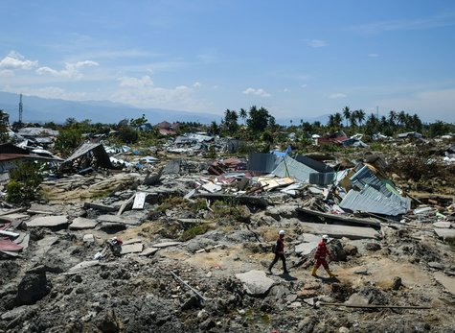
Problem Statement
Where are those in need?!
Global poverty concentrated
A lack of fine grained, timely poverty measures hampers effective aid distribution
Data sparse context
(Fragile states, Subnational level)
Notes:
저는 이런 기법을 활용해서 빈곤을 측정하는데 관심이 있고, 특히 취약국과 같이 내전이 빈번하고, 인구의 강제이주로 인해 인구조사나 가구방문 서베이를 하기가 훨씬 더 어려운 곳은 신뢰할 만하고 시의적절한 데이터가 부족하여 이러한 대안적인 방법론이 유용할 것으로 보입니다.
Poverty is deepening around the world, and development aid from advanced countries to developing countries has a great potential to combat global poverty when targeting areas of concentrated need.
However, even in a world riddled with poverty, nearly every gov and aid agency struggle with the issue of finding the poor and pinpointing areas of greatest need.
In some developing countries, no standard decennial census collected. In Lebanon, it’s been about 70 years since the last census
Particularly, fragile and conflict-prone contexts with on-going civil strife and armed conflicts pose a significant challenges in locating those in need.
Relatively few aid determinant studies exist
But we don’t want to throw a dart in the dark but maximize the use of what’s available.
1.50
analyze subnational characteristics because as many of us know data at the lower administrative level is often unavailable or uncertain, and undermine our ability to shape resource allocation.
Where in Kigali should the Rwandan health ministry place a new health clinic? Where should be place a social service agency that minimize the cost of transportation for the poorest hh in Camden? All these decisions require (not just knowing the magnitude of poverty but) pinpointing areas of greatest need.
In some developing countries, no standard decennial census collected. In Lebanon, it’s been about 70 years since the last census
African national statistics off by as much as 50%. Official estimate of Ghanaian GDP Nov 4, 2010 US $6.9 billion, Nov 5, 2010, US 11.8 billion, More than a statistical tragedy, Ghana no longer eligible for concessional lending. (10 trillion $, exceedingly expensive ),
Particularly, fragile and conflict-prone contexts like M where there is significant civil strife and massive population displacement pose a significant challenges in locating those in need.
[FSs are governments incapable to fulfill basic security and services for their citizens ( fail to provide basic services and economic opportunities), and are unable to garner sufficient legitimacy to maintain citizens’ confidence and trust.]
[Fragility commonly relates to the failure to fulfill basic state tasks (causes) and resulting susceptibility to insecurity of people (results)]
Adding another layer of difficulty, relatively few aid determinant studies analyze subnational characteristics because as many of us know data at the lower administrative level is often unavailable or uncertain, and undermine our ability to shape resource allocation.
But we don’t want to throw a dart in the dark but maximize the use of what’s available. We can borrows tools in the data science to SD so that we can respond in this context (where we otherwise wouldn’t have any reliable data. 1:42 min
[Different parameters are used to identify fragility combining aspects of the capacity, legitimacy and accountability of institutions with indicators associated with conflict, risks, vulnerability, and instability. ]

Slide 9
Literature
Advancement has been made in remote sensing techniques with ML to predict socioeconomic factors
Converting this to be usable for targeting and evaluating aid distribution has been met with problems e.g., direct cash transfer
Performance of alternative poverty estimations have not been tested combining satellite imagery deep learning in a subnational aid distribution context
Notes:
따라서 저는 그간 remote sensing 을 활용한 사회경제 요인에 대한 예측관련 문헌 chen, neal, Abelson 등의 연구를 바탕으로 빈곤을 측정하는 다양한 대안적인 지표들을 테스트 해보고자 하였습니다. Chen et al. Jean, Neal et al.
Abelson, et al.
(Chen & Nordhaus 2011; Doll & Morley 2016; Jean et al. 2016)
(Abelson, 2014)

Slide 10
Research Questions
How do different poverty estimations perform in Myanmar?
To what degree does poverty predict aid per capita per village?
How well can ML models predict subnational aid distribution?
Notes:
이 테스트는 취약국이면서 빈곤데이터가 부족한 case country인 미얀마에서 하였구요.
그래서 본 연구는 미얀마를 대상으로 ML과 Spatial analysis를 통한 대안적 빈곤지표의 performance를 측정하고, 이러한 새로운 빈곤지표가 얼마나 aid를 예측하는지, 따라서 aid가 need에 맞게 쓰이는지 연구를 해왔습니다.

Slide 11
Research Questions
How do different poverty estimations perform?
Today’s talk focuses on this methodological question.
Notes:
하지만 오늘은 이러한 여러 연구질문중 특히 빈곤지표의 비교라는 방법론에 초점을 두고자 합니다.

Slide 12
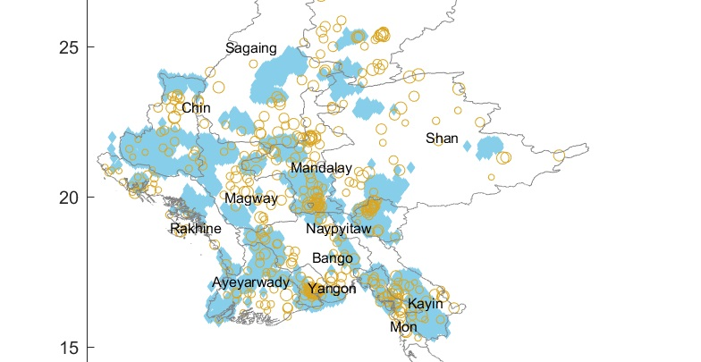

Data gap & evidence-based policy making
No ground-truth wealth data available
Notes:
이런 한 연구는 연구자 및 실무자 분들이 data gap을 채우고 이를 근거에 기반한 정책결정을 하는데 활용 가능합니다. 예를 들어 미얀마에 CCD 사업을 하는데, 사업지역에 대한 서베이를 통한 빈곤데이터가 부재하다면 이러한 missing data를 채울 수 있게 해주는 것이죠.

Slide 13
Data

Slide 14
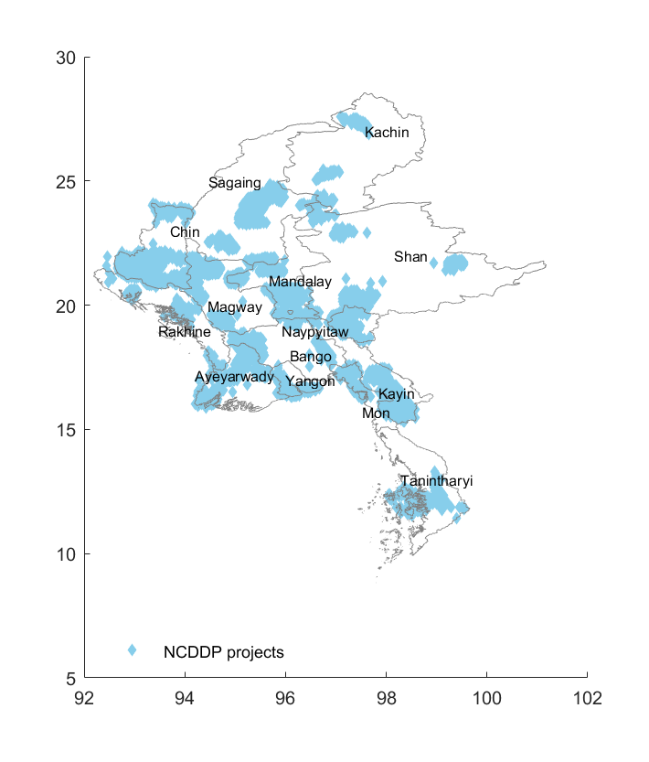
Data 1: Aid location
latitude
Geo-referenced CDD (NCDDP) data in 2015 (n=12,504)
Developed automated webscraping algorithms
longitude
Notes:
먼저 제가 사용한 데이타에 대해서 간단히 소개드리겠습니다. 첫번째는 미얀마 전역에 2015년 CDD 사업을 했던 village의 geo referenced 된 위치 데이터를 사용하였습니다. 제가 연구하던 작년 가장 최신 데이터 였고, web scraping을 통해 자동으로 원조 사업 위치를 collect 할 수 있는 알고리듬을 통해 취합을 하였습니다.
This project relies on 6 sources of data. First,we automized webscrapping process and collected 12,000 CDD locations from the project management web portal. Satellite images of luminosity at night can be used as a proxy for the intensity of economic production. An indicator of needs particularly relevant to fragile states is conflict.
Use 5650 out of 8888
A specific measure tailored to humanitarian and development program is the adjusted vulnerability index at the township level. The multidimensional index reflects components of human development alongside the impact of conflict and violence, through a desk review and analysis of national datasets and information at township level over the period 2014-2016. Aid actors are involved in producing and financing the vulnerability data review. The data is from the MIMU and the Humanitarian Assistance and Resilience Programme Facility (HARP-F), both of which are actively involved in aid.

Slide 15
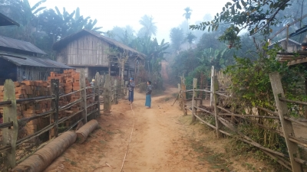
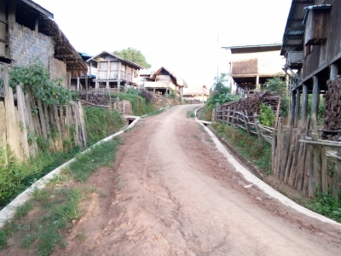
Intervention: Community-driven Development (CDD)
Before
After
Notes:
CDD는 잘 아시겠지만 community 에 block grant를 주고 주민들이 사업 기획과 집행에 참여하는 프로젝트이고, 지금 이 Pyit Saing 마을에서는 농장과 농장을 있는 도로를 만들었습니다.
The analysis is limited to poverty-oriented and participatory interventions commonly practiced in FS (in transition from dictatorship to democracy. )
The crux of the CLD approach is that aid-receiving communities, rather than external donors, make decisions about development projects they would like to launch and implement. The choice of policy design that allows more user control is the funding arrangement; CDD is in the form of a block grant.
The Pyit Saing village improved their farm-to-farm dirt road.
1 min
Example 44% Transport (road, bridges, footpaths, jetties), health, electrification, education community facilities, water and sanitation.
(FS is becoming increasingly popular among donors like the WB as a common aid modality in fragile context transitioning from dictatorship to democracy. )

Slide 16
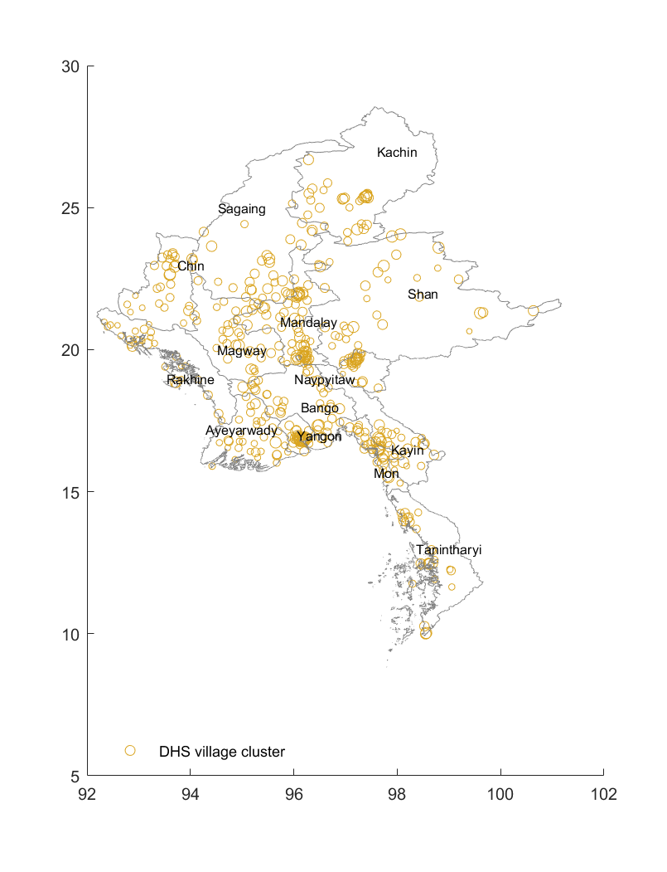
Data 2: Wealth
latitude
DHS wealth (asset) index / factor scores (n=441 village clusters)
longitude
Notes:
다음으로 441개 마을 클러스터에서 측정된 DHS wealth index 를 활용하였는데 이 지표는 자산의 유무와 관련된 빈곤의 대용지표입니다.
This project relies on 6 sources of data. First,we automized webscrapping process and collected 12,000 CDD locations from the project management web portal. Satellite images of luminosity at night can be used as a proxy for the intensity of economic production. An indicator of needs particularly relevant to fragile states is conflict.
Use 5650 out of 8888
A specific measure tailored to humanitarian and development program is the adjusted vulnerability index at the township level. The multidimensional index reflects components of human development alongside the impact of conflict and violence, through a desk review and analysis of national datasets and information at township level over the period 2014-2016. Aid actors are involved in producing and financing the vulnerability data review. The data is from the MIMU and the Humanitarian Assistance and Resilience Programme Facility (HARP-F), both of which are actively involved in aid.

Slide 17
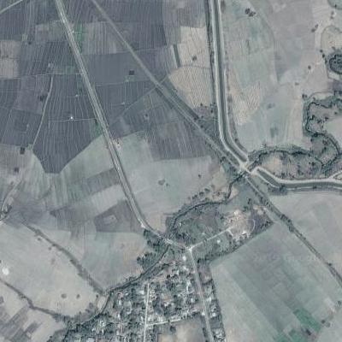
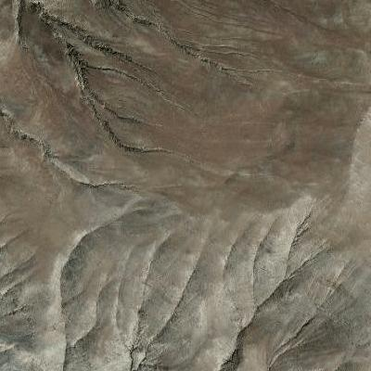
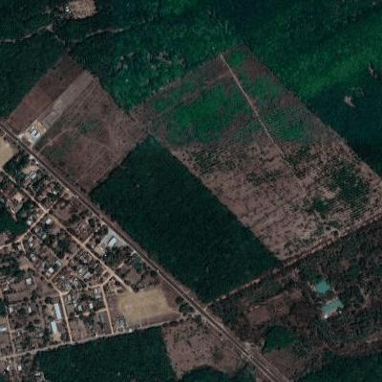
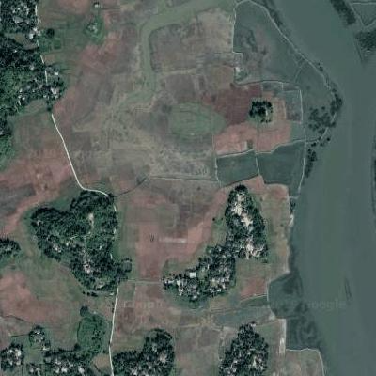
Data 3: Daytime Satellite Imagery
50,000
400x400 pixels
Areas near locations with DHS or aid data
Notes:
그리고 google API를 통해 얻은 5만개 가량의 dhs cluster 및 aid 사업근교 인공위성 사진을 쎳는데, 각 사진은 400by 400 pixel로 이루어져있고,
This study suggests a few avenues for future research.
The image (right) shows Myanmar’s predicted village wealth data, as trained by DHS datasets with basic satellite image processing. Villages with a high predicted wealth value are represented by a green dot, mid-level wealth with a yellow dot, and low-wealth with a red dot. Nightlight luminosity (below) as a predictor of wealth scored lower than a model predicted on daytime images, so only day images were used.
The accuracy of different poverty measure can also be compared and evaluated. For instance, multi-spectra daytime satellite imagery, single-band nightlight data, and geospatial interpolation such as kriging, can be trained to predict wealth using the DHS and the best performing measures can be used to study aid distribution (working paper). The results of this study are consistent with the author’s work in progress that uses daytime satellite imagery to measure poverty and predict CLD aid per capita in Myanmar.
Kriging method accounts for spatial auto correlation between wealth and nightlights.

Slide 18

Data 4: Nightlights
Mandalay city
Nay Pyi Taw
Yangon
Notes:
또한 gio tif 이미지 파일에서 nightlight luminosity를 추출하였는데, 과거 수도였던 세 도시의 빛이 밝은 것을 알 수 있습니다.
The measurement unit for luminosity is a composite cloud-free radiance value estimated in 15 arc-second (Approximately 463 m) geographic grids with outliers removed and non-lights set to zero.
I measured wealth more than one way, using Satellite image of night lights. NL are measured by a composite radiance value
Almost all consumption and investment activities in the evening or night require lightening, and the intensity of night lights can be used as a proxy for economic activity when there is no other measures and they’re globally available and consistent.
Satellite images of luminosity at night can be used as a proxy for the intensity of economic production in countries with low-quality statistics systems (Donaldson & Storeygard, 2016). Three major cities, Mandalay city, Yangon, and Nay Pyi Taw have the brightest nightlights. Drawn from 2015 and 2016 nighttime raster data, the annual average luminosity values are estimated at the 441 DHS village clusters and 12,282 CLD project villages at various resolutions. I use the resolutions of 5 km by 5 km, 10 km by 10 km, and 2 km for urban and 10 km for rural areas, considering any noise effects present in the data (Bruederle and Hodler, 2017; Doll & Morley 2016). The measurement unit for luminosity is a composite cloud-free radiance value estimated in 15 arc-second (Approximately 463 m) geographic grids with outliers removed and non-lights set to zero.
Following Doll & Morley (2016), aggregating up reduces any noise effects present in the data. Some noise is added to the geocoordinates of the center points of DHS clusters by displacing each cluster center point in a random direction and by a random distance of 0-2 km for urban clusters, and 0-5 km for rural clusters, with 1 % of rural clusters displaced by up to 10 km (Bruederle and Hodler, 2017).

Slide 19
Analysis

Slide 20
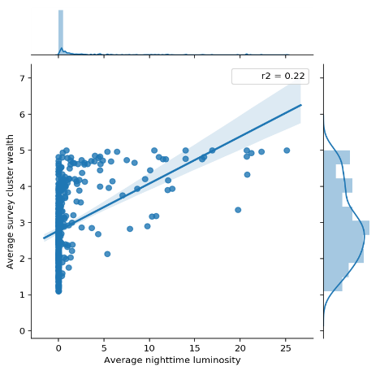
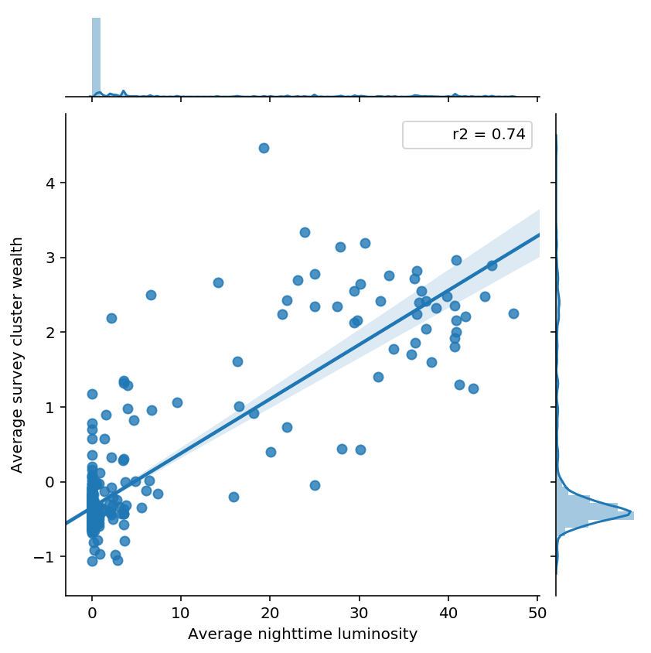
1. Nightlights predict wealth
Myanmar R²=0.22
Rwanda R²=0.74
Wealth
Wealth
Nightlights luminosity
Nightlights luminosity
Haiti R² =0.31, Nepal R² =0.37
Notes:
Haiti (0.31) and another South Asian country, Nepal (0.37).
That is we estimate the out of sample error using the portion of data left out of the fitting procedure. We repeat this k times and our estimate for the out of sample error is the the average over the k validation runs.
The measurement unit for luminosity is a composite cloud-free radiance value estimated in 15 arc-second (Approximately 463 m) geographic grids with outliers removed and non-lights set to zero.
Nightlight Version 1 VIIRS Day/Night Band rater data, 2015-2016 (Tile 3: 75N /60E) DMSP/OLS Nighttime Light

Slide 21
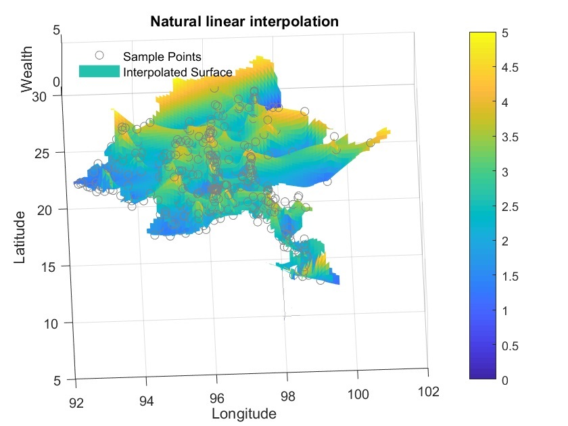
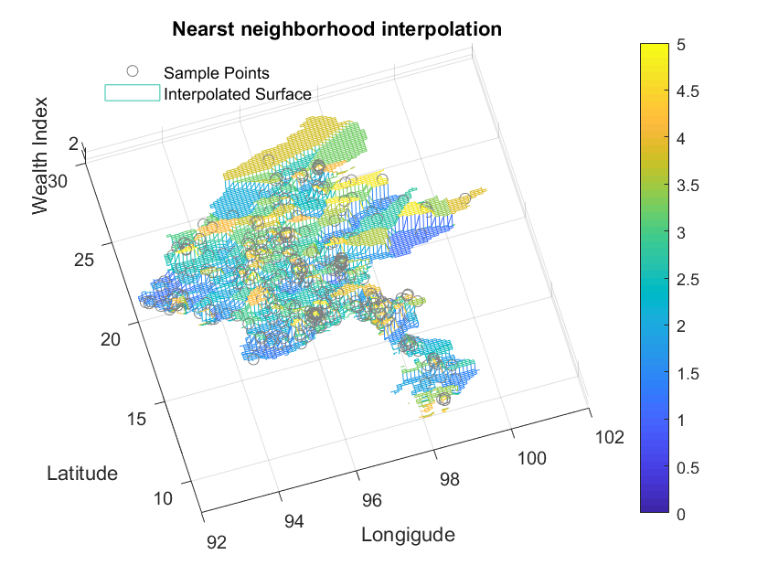

2. Spatial interpolation
Longitude
Notes:
Deterministic vs geo statistical approaches to spatial interpolation
Linear interpolation. This method fits a different linear polynomial between each pair of data points for curves, or between sets of three points for surfaces. Linear interpolation (default), where the interpolating surface is C0 continuous.
Nearest neighbor interpolation. This method sets the value of an interpolated point to the value of the nearest data point. Therefore, this method does not generate any new data points. Nearest-neighbor interpolation, where the interpolating surface is discontinuous.
Natural-neighbor interpolation, where the interpolating surface is C1 continuous except at the sample points. Smoother interpolation function
https://www.mathworks.com/help/matlab/math/interpolating-scattered-data.html

Slide 22
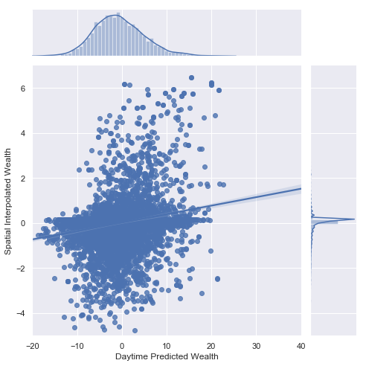
Spatial Interpolation (kriging)
Kriging (Gaussian Process Regression) method with a squared exponential kernel
R² = 0.208
Correlation between daytime imagery prediction and spatial interpolated prediction
Day time predicted wealth index vs Kriging
Notes:
https://www.aspexit.com/en/spatial-data-interpolation-tin-idw-kriging-block-kriging-co-kriging-what-are-the-differences/
Kriging is the most commonly used geostatistical approach for spatial interpolation. Kriging techniques rely on a spatial model between observations (defined by a variogram) to predict attribute values at unsampled locations. One of the specificity of kriging methods is that they do not only consider the distance between observations but they also intend to capture the spatial structure in the data by comparing observations separated by specific spatial distances two at a time.
Kriging methods consider that the process that originated the data can be divided into two major components : a deterministic trend (large scale variations) and an autocorrelated error (the residuals).
Z(s)=m (deterministic trend)+e(residual: an auto correlated error)
Where Z(s) is the attribute value at the spatial position s, m is the deterministic trend that does not depend on the location s of the observations and e(s) is the autocorrelated error term (which depends on the spatial position s). Note that the trend is deterministic ! The variogram is only computed on the residuals which are supposed to exhibit a spatial correlation !
The basic idea of kriging is to predict the value of a function at a given point by computing a weighted average of the known values of the function in the neighborhood of the point.
We also tried spatial interpolation to get predicted wealth index for aid locations.
We used Kriging approach and the model was trained and tested on DHS data, but the performance is not as good as daytime imagery.
The plot shows the correlation of wealth index predicted by daytime imagery and kriging method.

Slide 23
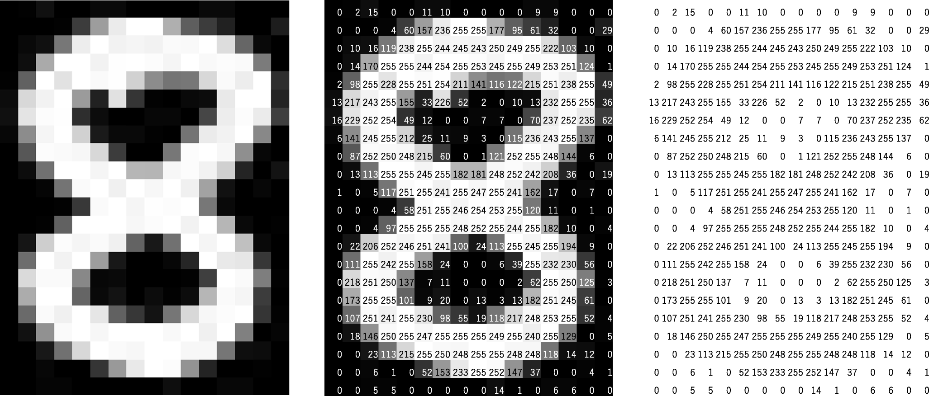
3. Daytime satellite imagery
Nightlights: 1 dimension
Daytime images: 3 channels

Slide 24
Daytime satellite image: Intuition
Isolated image
Original
Highlight presence of a given feature in the image
Isolate pixels where the RGB channels>120 → buildings
Images with a large portion of brighter areas as a proxy for economic development
Notes:
Queried the NASA to retrieve satellite images
Go register for google maps API keys and download 25000 images per day.
Each couple years there is new iteration, the state of the art right now is that the company in SF, called planet labs, image every surface every see.
Sometimes, those Clouds you can’t actually see the surface. Take picture, use those rapidly changes sat image as new avenue towards measuring changes in wealth
Limitation, fundamental, that raw data source contains enough fundamental variation that allow you to estimate the things you’d like to estimate.
Wealth roofing materials, road quality etc, want to measure like whether someone in the hh is sick or under violence, it’s not obvious that you can get it from sat images.
Epidemiology and internal displacement, that requires the unit of aggregation is not spatial – track people over time.
1.5 min
NN Estimate village wealth from Satellite imagery, go get sat imgery using google API, we’ll match it with regionally aggregated data from existing hh surveys downloaded from the WB or UN.
Nightlights show variation at higher income levels. Nightlights also have difficulty distinguishing between poor, densely populated areas and wealthy sparsely populated areas. Not using nightlights to estimate per capital consumption.
Regions that have certain very characteristic features are going to be systematically weather or poorer than others.
Look at the Satellite imagery , there are things in the sat imagery that intuitively you might expect to be correlated with the wealth of that region,
How many buildings are there that have very reflective roofing materials, distance to urban areas vary roughly linearly with expenditure and thus better capture variation maong poorer clusters. the roads very well paved, are there dirt roads?
These transfer learning approach do much better in predicting poverty in regions that’re particularly poor.
Day of the images with the days of the survey?
Why average of the 30 hh? Mean? Most obvious things to do?
Average of 500 , averaging across images
Take a short cut.
This is a field that didn’t exist ; Top econ journals and nature and science is hugely problematic.
*Satellite approach has several advantages: Global coverage and can be obtained from public sources, Technology is rapidly improving, fewer privacy concerns
*Some limitations: Not everything is visible in overhead imagery, Uncertain ability to detect dynamic changes, Some applications require focus on individuals
Estimate poverty down load that covers the region corresponding to that cluster centroid,
You can imagine and face book have done this. Paved well or poorly paved, Map that with the
NN automatically extract characteristics of these images, Not like how many cars or hh, automimic features that come out of these deep learning algorithms
Feature extra, image 400*400 pix=1600 points in that images each has three channels (1600*3=4800), - collapse that into a set of a features, that empirically computer vision researchers have found really summarize a lot of the latent variations in images, you get manageable feature vector say of length of 100-496 matrix that summarize the picture. What that image actually contain. – latent variation
Nice rectangular matrix of 500 observations – one for each of the cluster of hh, - label, average wealth index of all of the 30 hh in that cluster.
Predictor variable extracted from these images automatically – here 10*10 grid images that cover this survey location, each of those images produces 1000 dimensional feature vectors, We have 100 images, Average of the 100 pictures; 1000 average characteristics
Just using nightlights, you do pretty well in regions , informally dark, using the day time imagery gets you a lot better predicted accuracy.
Because you can tell very poor region in satellite imagery in a
Trained deep neural , (train their images to label // cats, optimally predict that, , key features that we use this tasks, empirically work,
Cat and dog – edge detectors, images with sharp lines, some features pick up straighlight line or curve line.
Worry about overfitting/ selection bias. But can use regularization , loss function , impose a penalty on the complexity of F. restrictions for smoothness,
The least-squares method; to improve the generalizability of a learned model. Cross-validation, partitioning a sample of data into complementary subsets,
Deep learning allows computational models that are composed of multiple processing layers to learn representations of data with multiple levels of abstraction. These methods have dramatically improved the state-of-the-art in speech recognition, visual object recognition, object detection and many other domains such as drug discovery and genomics. Deep learning discovers intricate structure in large data sets by using the backpropagation algorithm to indicate how a machine should change its internal parameters that are used to compute the representation in each layer from the representation in the previous layer. Deep convolutional nets have brought about breakthroughs in processing images, video, speech and audio, whereas recurrent nets have shone light on sequential data such as text and speech.

Slide 25
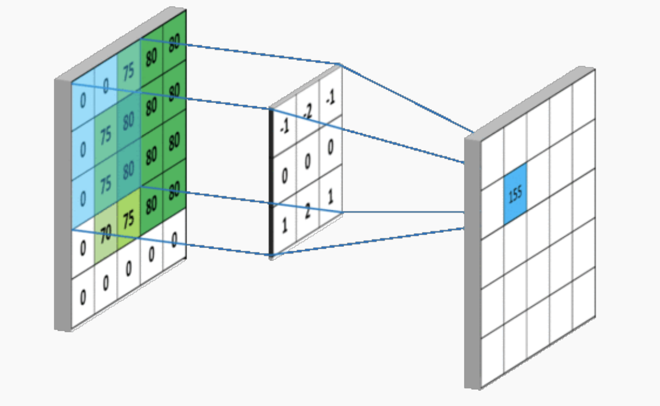
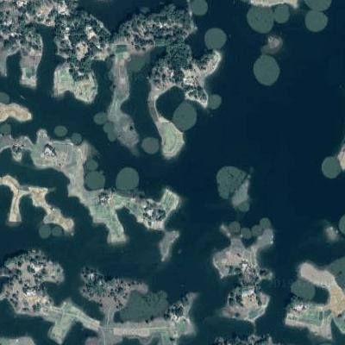
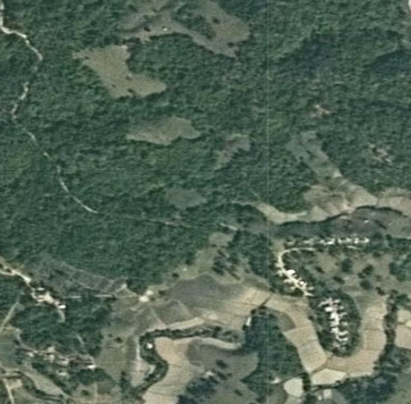
Feature extraction with deep learning
p
1?
0?
Pooling
(maxpooling)
Classification
(softmax)
Kernel
+non-linear
activation function
Our eyes
(raw image)
Computer vision
(array of pixel values)
Feature map
Notes:
Filters/Kernels: Detect important features (edges/ corners, parts/ shapes, positions)
Pooling: Reduce dimensions
Classification: Output layer
75+80=155
Any computer sees an image like array of pixel values https://www.videonet9.com/using-neural-networks-for-video-surveillance.html
An output channel of the convolutions is called a feature map. It encodes the presence or absence, and degree of presence of the feature it detects.
Relu (a RECTIFIED LINEAR UNIT activation function) decides whether a certain feature is present at a given location in the image. It is a non-linear activation function

Slide 26
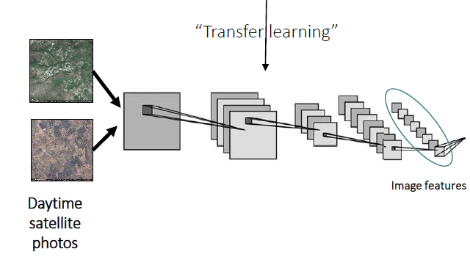
Convolution Neural Network and transfer learning
Pre-trained on image net to identify low-level image features
The trained CNN has learned a nonlinear mapping from each input image to a feature vector representation
Fit ridge regression models to estimate DHS wealth
  Regularization: 4,097 features & small survey data sets
  R² : 0.477
Wealth
Notes:
(edges and corners) that are common to many vision tasks
Regularization Guard against

Slide 27
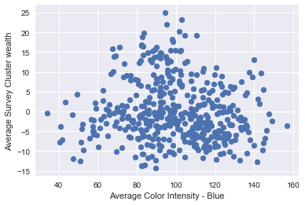
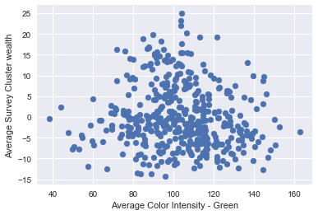
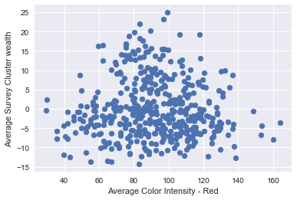
4. Color distribution as image features
Red
Green
Blue
Use simple color distribution as our image features
R² = 0.388

Slide 28
Model comparison
 | CNN with daytime image | RGB average pixel features | Geospatial interpolation (Kriging) | Nighttime data
R² | 0.477 | 0.388 | 0.21 | 0.18
Notes:
Deep learning allows computational models that are composed of multiple processing layers to learn representations of data with multiple levels of abstraction. These methods have dramatically improved the state-of-the-art in speech recognition, visual object recognition, object detection and many other domains such as drug discovery and genomics. Deep learning discovers intricate structure in large data sets by using the backpropagation algorithm to indicate how a machine should change its internal parameters that are used to compute the representation in each layer from the representation in the previous layer. Deep convolutional nets have brought about breakthroughs in processing images, video, speech and audio, whereas recurrent nets have shone light on sequential data such as text and speech.

Slide 29
Conclusions

Slide 30
Findings and implications
Using daytime satellite imagery with deep learning was an improvement → Predict aid distribution with more accuracy
Explore new data sources & novel poverty estimation techniques → Promote evidence-based targeting at low cost
Notes:
A simple linear regression alone can correlate to wealth
Could be employed by policy makers
52 million inidivuals over 70,000 villages, 441 DHS entries.

Slide 31
Findings and implications (cont.)
Relatively moderate performance
  Country’s size (geographic size and population)
    Myanmar 676,000 km² (53 mil people)
    vs Rwanda 26,000 km² (12 mil people)
  Geographic variance
    Between the training data (DHS surveyed locations) and the test data (aid locations)
    A range of geographical features (e.g., mountain ranges, rivers, forests)
Notes:
Small training set with limited DHS dataset
The models developed to predict the wealth of Myanmar’s villages relatively low

Slide 32
Methodological discussion
How to improve performance
  A collection of ground-truth (labeled) data
  A more sophisticated CNN with fine-tuned parameters
  Train by agro ecological zones, geographic dimensions (north/south), seasons
A range of spatial representation and scale
  Point, polygon, field, lines, networks
  Resolution: noise vs more granular data
  Spatial aggregation

Slide 33
Methodological discussion (cont.)
Computational complexity vs. High performance
  Applications of transfer learning
    Image Net worked well
    Using nighttime images as an intermediate step is not always feasible or better

Slide 34
Thank you.

